Slide 1

CRIME DIFFERENCE IN THE WEST MIDLANDS IN AUGUST 2020 VS AUGUST 2021
Group 1 - Hibaa Aldubai, Farah Hayat, Badrija Khalifa, Kazimierz Lubas, Anderson Safo

Slide 2
DATA CLEANING
DIFFERENCE IN CRIME NUMBERS
INTRODUCTION
TABLE
OF
CONTENTS
CRIME LOCATIONS
MOST COMMON CRIME TYPE
CRIME OUTCOMES
OUTCOMES & CONCLUSIONS

Slide 3
INTRODUCTION
For this project, we chose to look at crimes within the West Midlands during the month of August across 2020 and 2021. We picked the West Midlands over other regions as that is where most of us live and work.
We wanted to see if the Covid-19 pandemic had an effect on the crime rate.
We predicted that there would be less crimes committed in 2020 due to most of the population either working from home or on furlough which meant that there were less people in public and therefore less crime. There were also stricter lockdown laws and many people were still following government recommendations to stay at home compared to 2021 were the rules were more relaxed.

Slide 4
DATA CLEANING
We obtained our data from https://data.police.uk/docs/ - API documentation.
We downloaded 2 CSV files for 2 months that we decided to focus on: August 2020 ("2021-08-west-midlands-street") - 12 columns, 28,452 rows August 2021 ("2021-08-west-midlands-street") - 12 columns, 32,096 rows
Both data frames were then merged into one to create a large dataframe with 12 columns and 60,548 rows.
We then cleaned the dataframe by removing 7 columns that contained information we didn’t find useful and dropped the rows that contained empty cells.
The final dataframe contained 7 columns and 53,090 rows with each row representing a different crime.

Slide 5
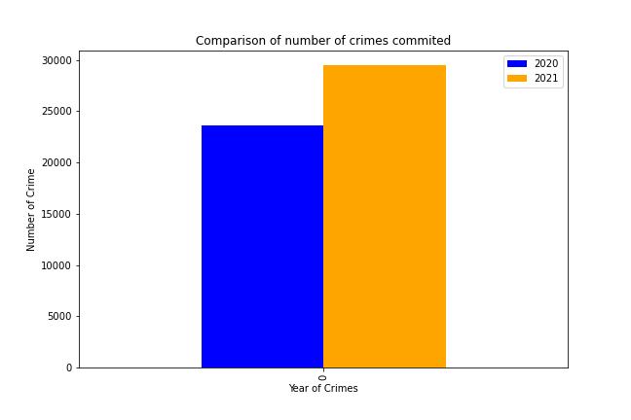
DIFFERENCE IN CRIME NUMBERS
Fully recorded crimes in August 2020: 23644
Fully recorded crimes in August 2021: 29446

Slide 6
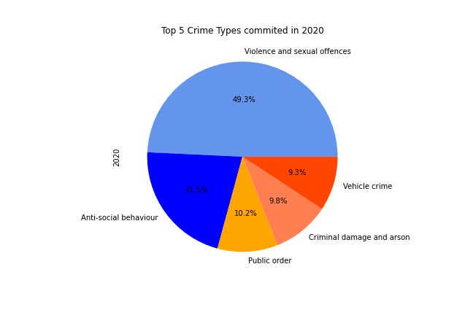
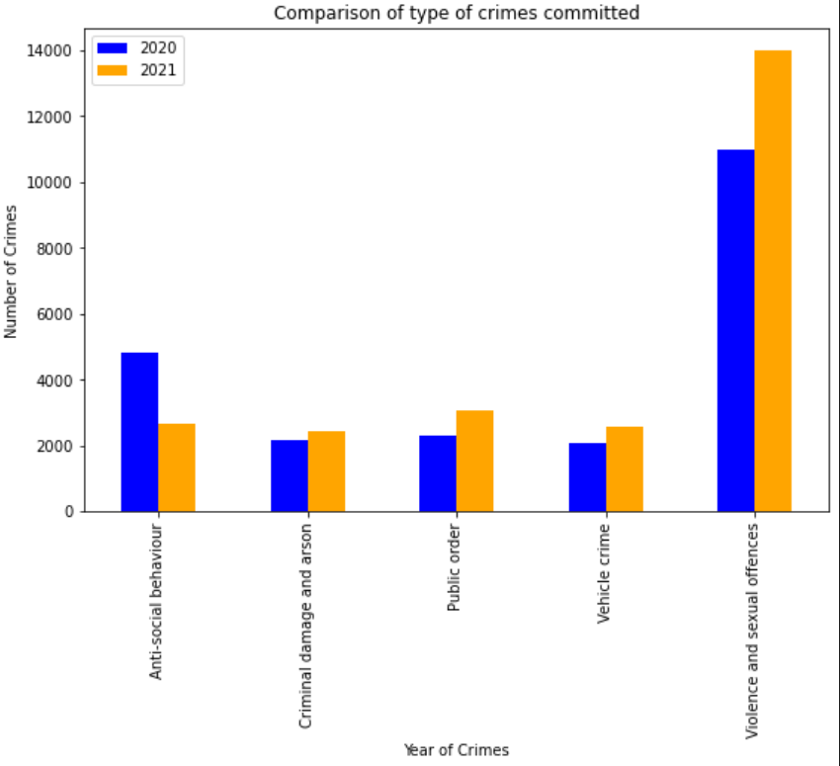
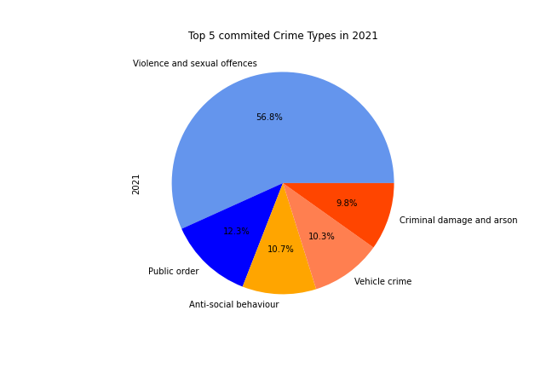
TOP 5 TYPES OF CRIMES COMMITTED

Slide 7
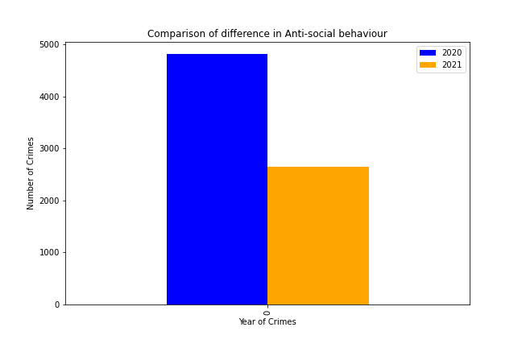
ANTI-SOCIAL BEHAVIOUR

Slide 8
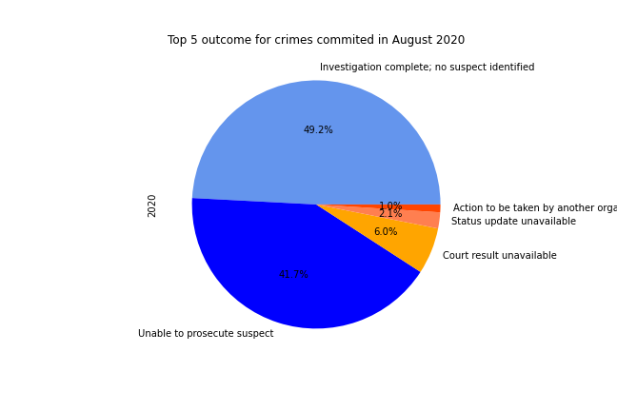
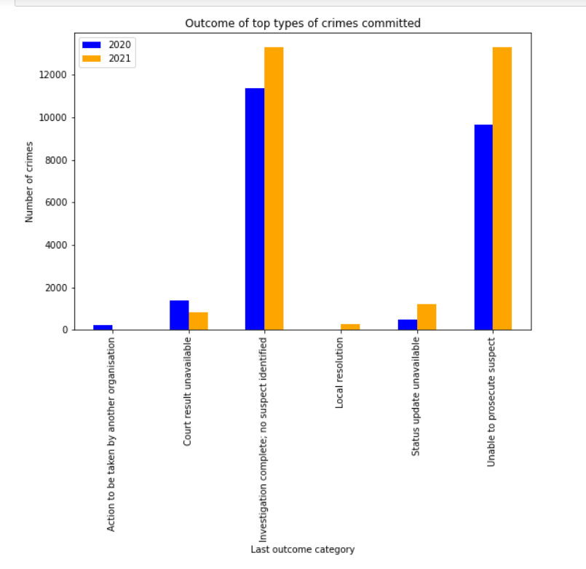
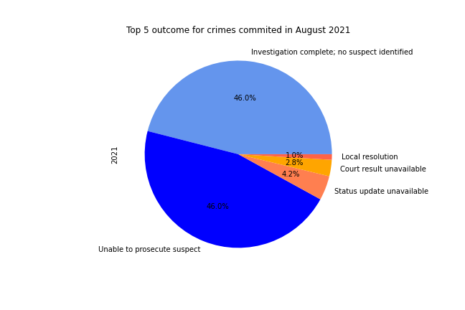
TOP CRIME OUTCOMES

Slide 9
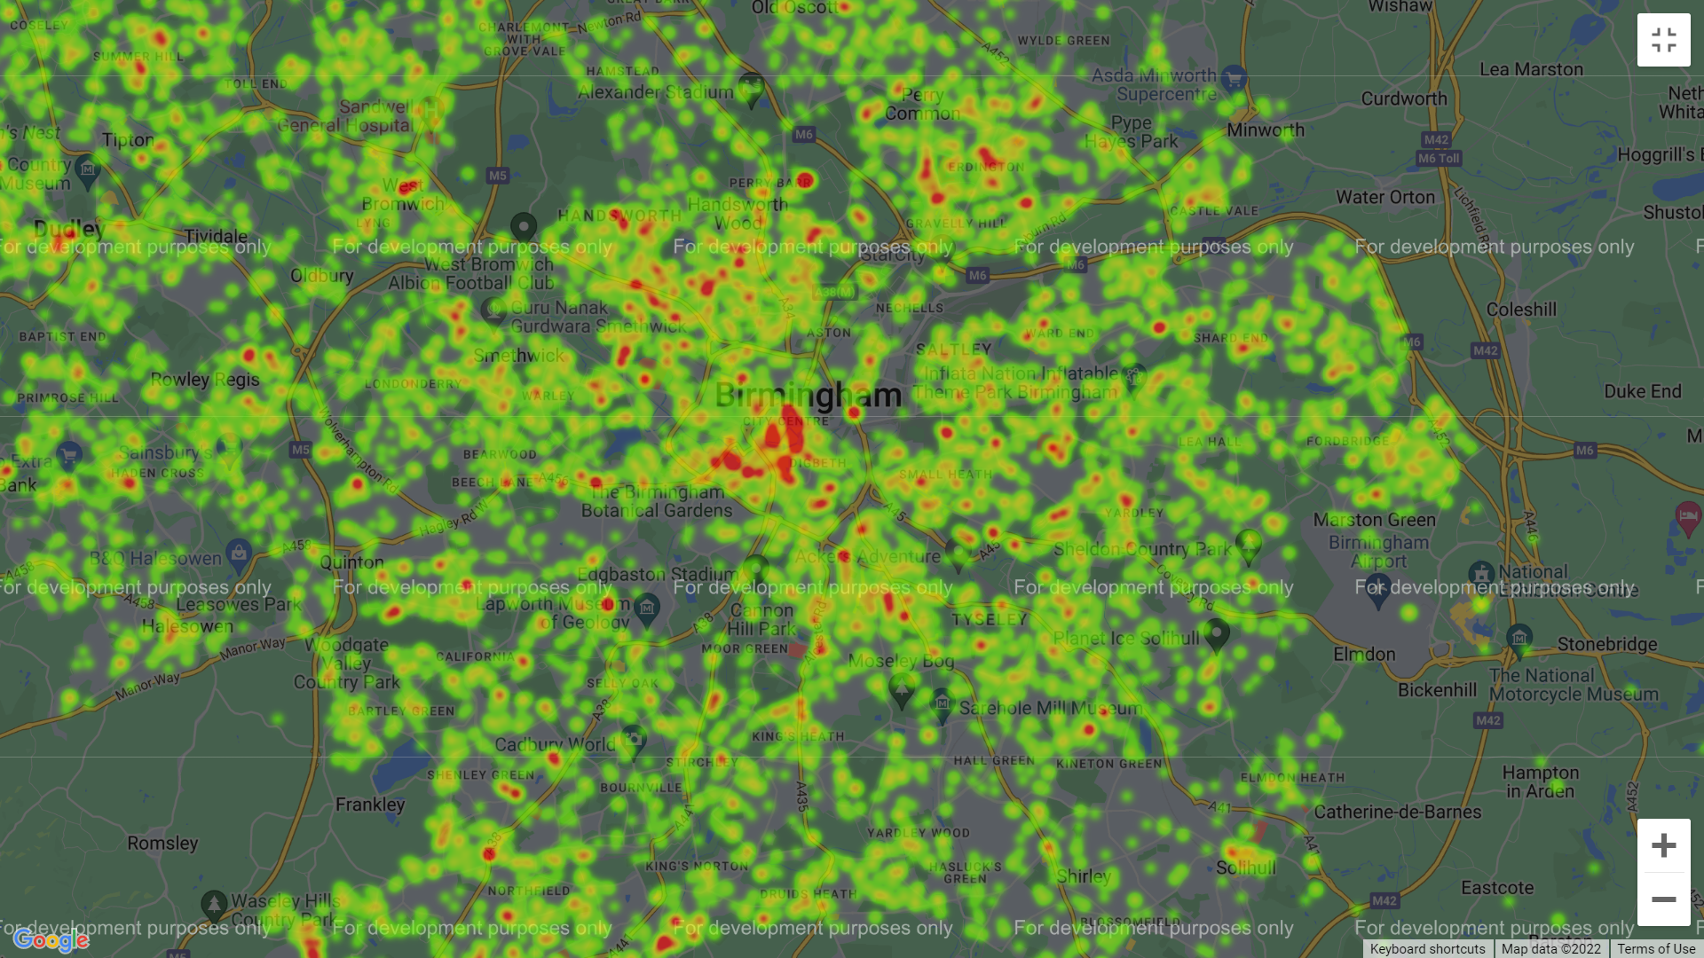
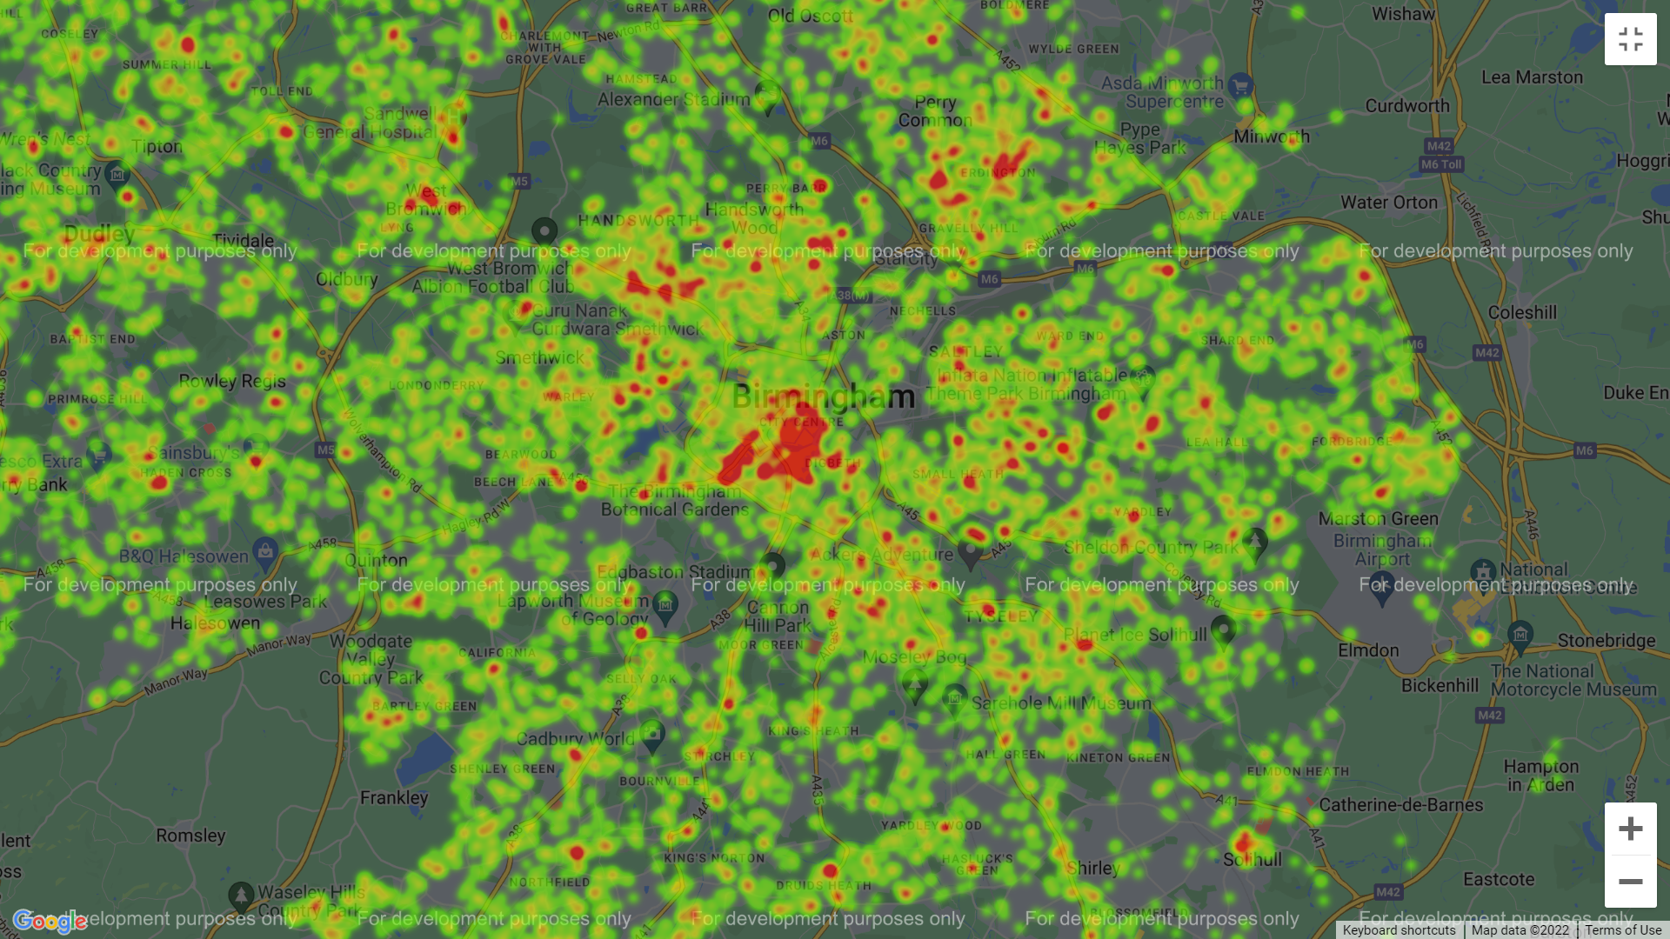
LOCATION OF TOP 5 CRIMES IN BIRMINGHAM
2020
2021

Slide 10
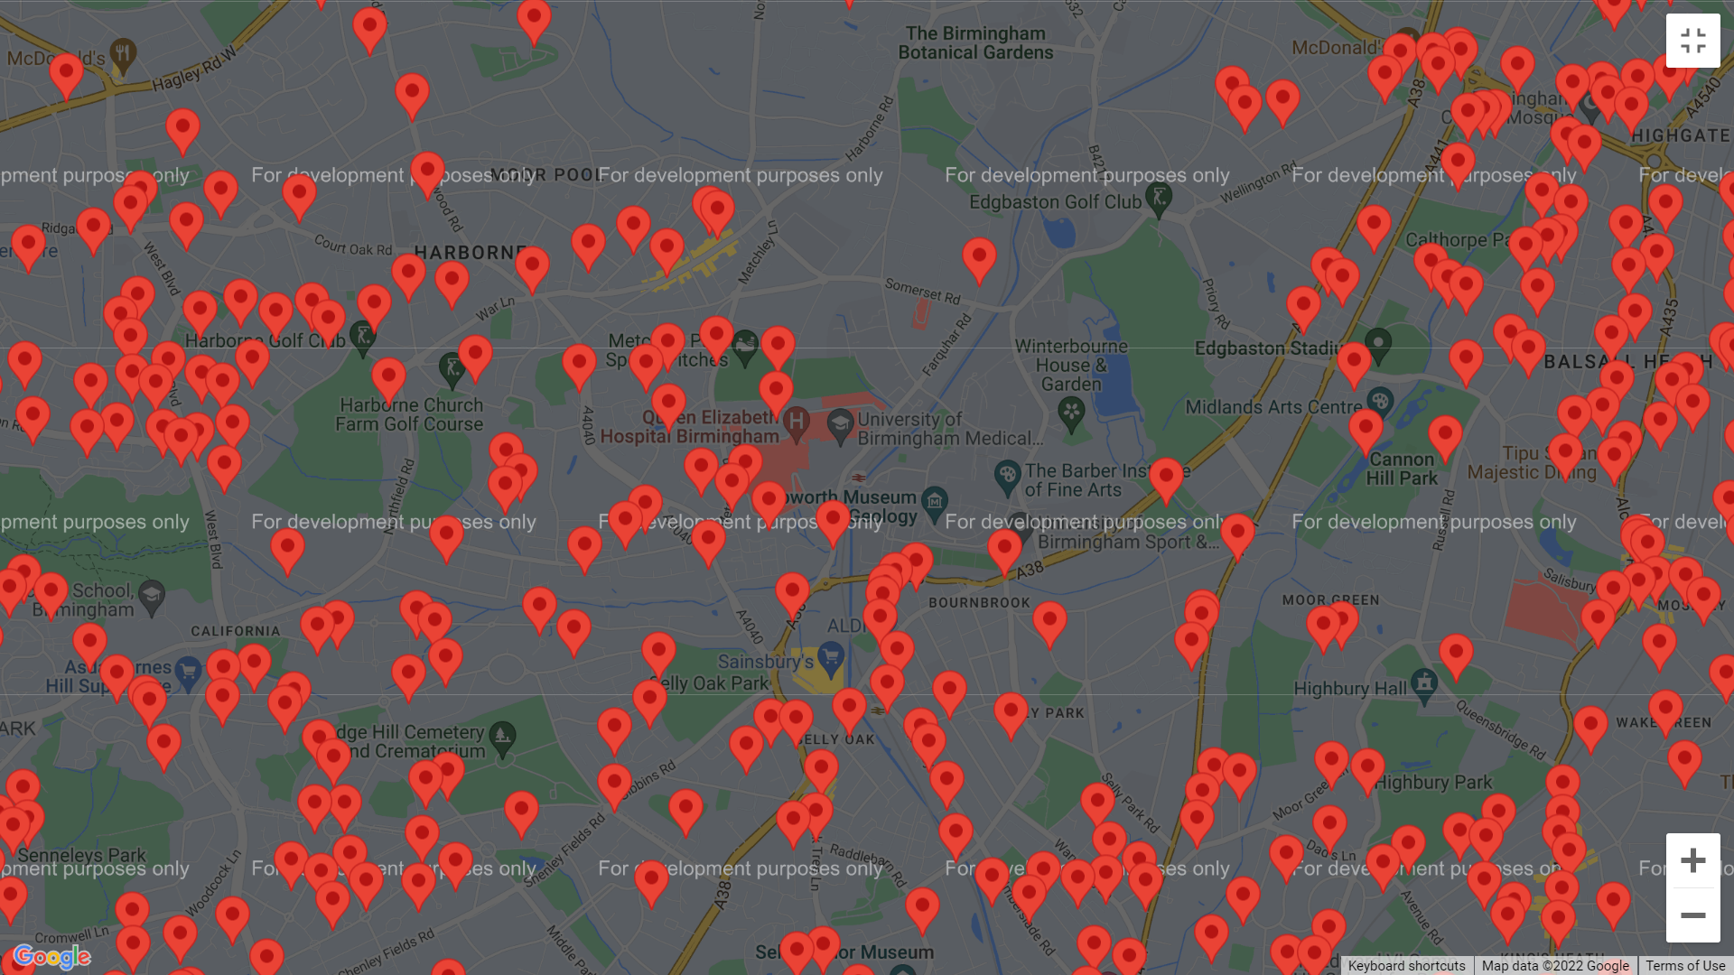
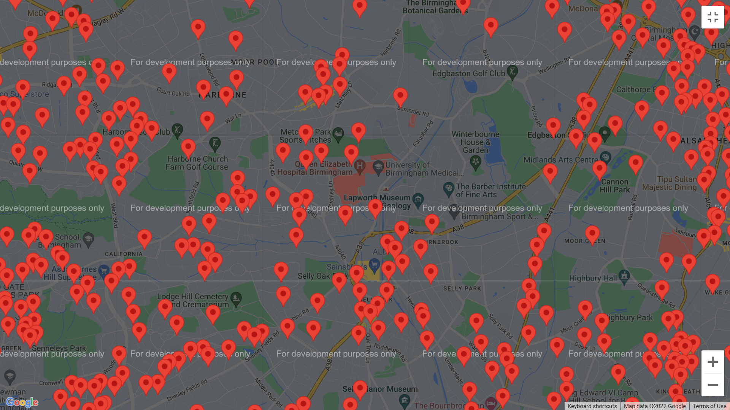
VIOLENCE AND SEXUAL OFFENCES
University of Birmingham
2020
2021

Slide 11
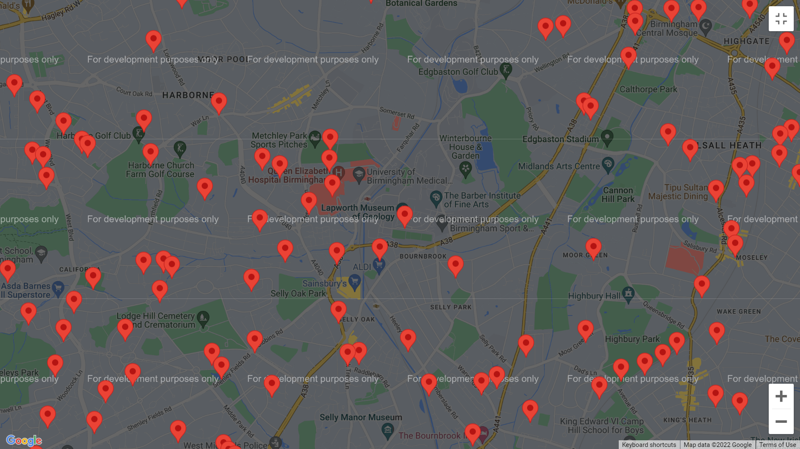
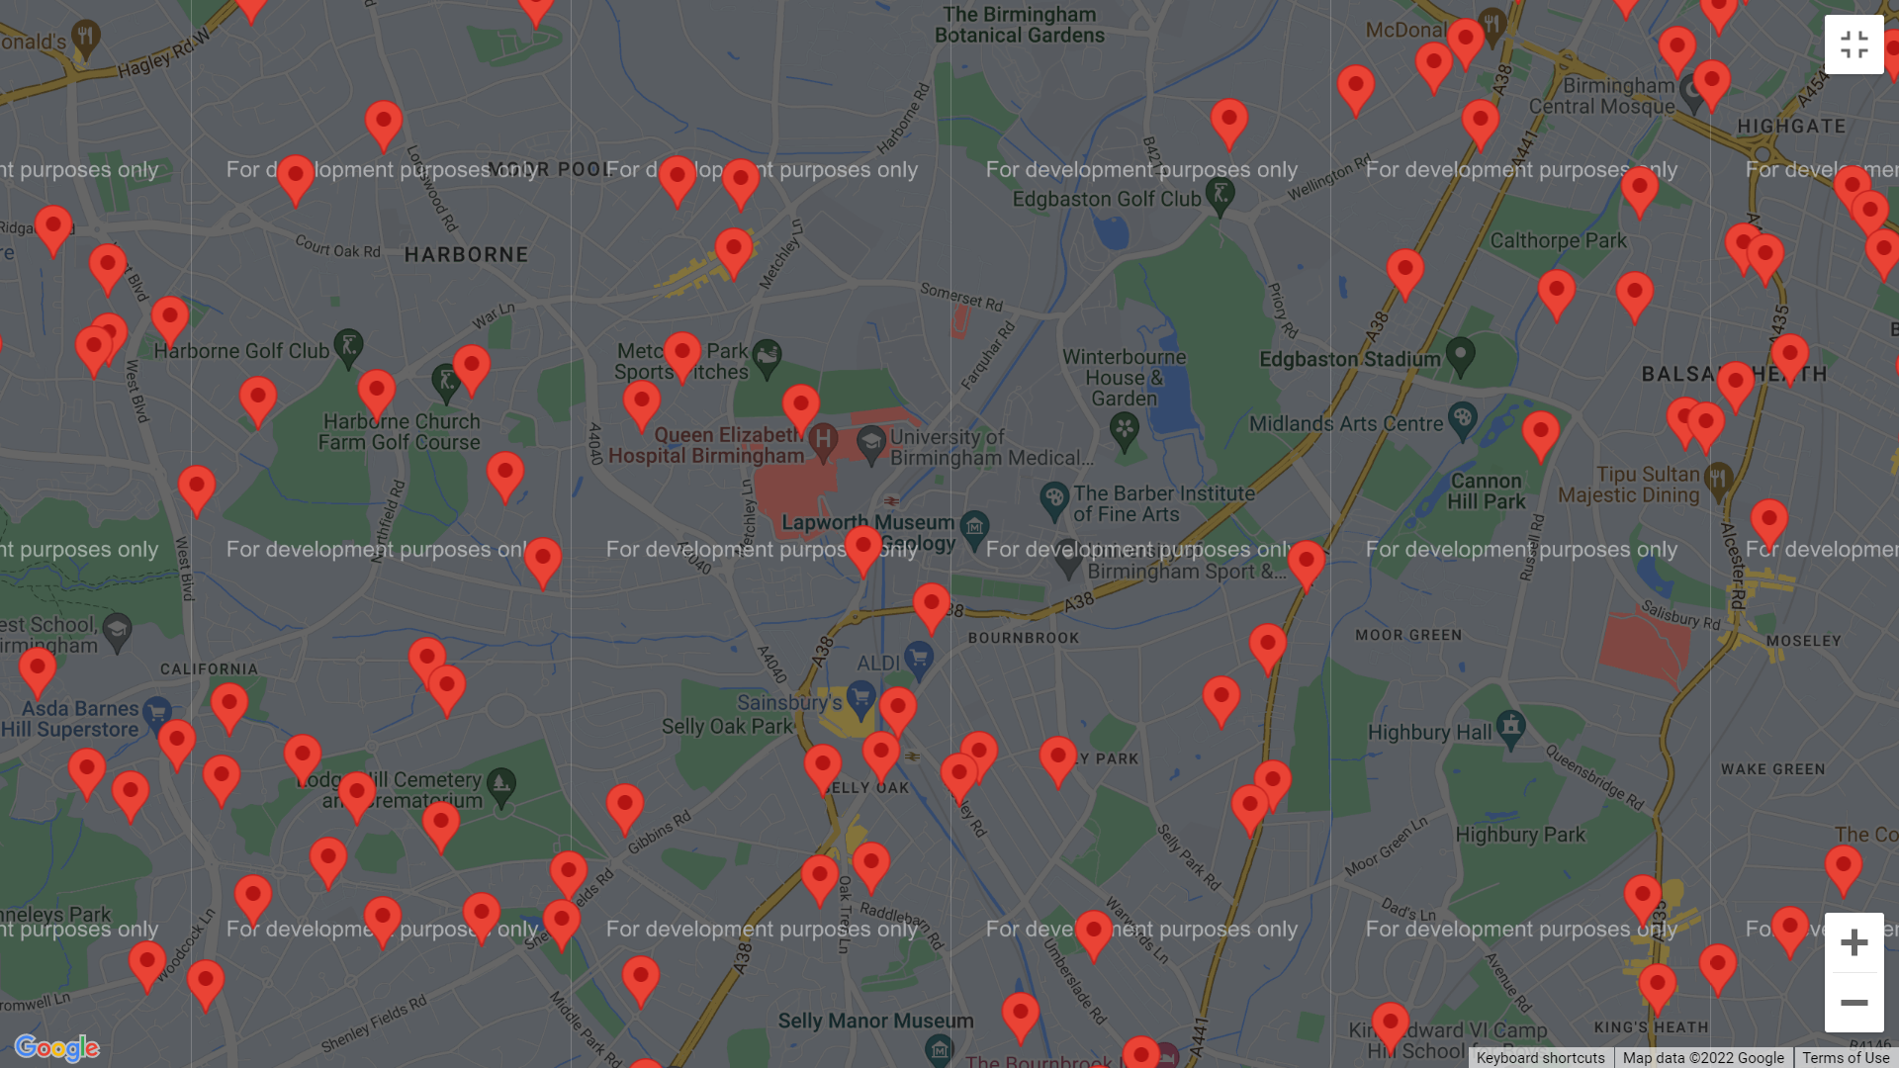
CRIMINAL DAMAGE AND ARSON
University of Birmingham
2020
2021

Slide 12
OUTCOMES AND CONCLUSIONS
Total number of crimes – slight increase in 2021 most likely because of covid but there could be other reasons
2020 many people were furloughed or made redundant and stayed at home
2021 furlough payment stopped so could resort In more crime
2020 unsure about the pandemic, masks and social distancing
More relaxed in 2021
Eat out to help out scheme may have affected the number of crimes as it was august 2020

